Slide 1
causal inference: an introduction and some results
Alex Dimakis
UT Austin
joint work with
Murat Kocaoglu, Karthik Shanmugam
Sriram Vishwanath, Babak Hassibi

Slide 2
Overview
Discovering causal directions
Part 1: Interventions and how to design them
Chordal graphs and combinatorics
Part 2: If you cannot intervene: entropic causality
A theorem of identifiability
A practical algorithm for Shannon entropy causal inference
Good empirical performance on standard benchmark
Many open problems

Slide 3
Disclaimer
There are many frameworks of causality
For time-series: Granger causality
Potential Outcomes / CounterFactuals framework (Imbens & Rubin)
Pearl’s structural equation models with independent errors
Additive models, Dawid’s decision-oriented approach, Information Geometry, many others…

Slide 4
Overview
Discovering causal directions
Part 1: Interventions and how to design them
Chordal graphs and combinatorics
Part 2: A new model: entropic causality
A theorem of identifiability
A practical algorithm for Shannon entropy causal inference
Good empirical performance on standard benchmark
Many open problems

Slide 5
Smoking causes cancer
Observational data
Joint pdf
S: Heavy smoker | C: Lung cancer before 60
0 | 0
1 | 1
0 | 1
1 …. | 1 ….
 | S=0 | S=1
C=0 | 30/100 | 10/100
C=1 | 20/100 | 40/100

Slide 6
Causality= mechanism
S
C
Pr(S,C)

Slide 7

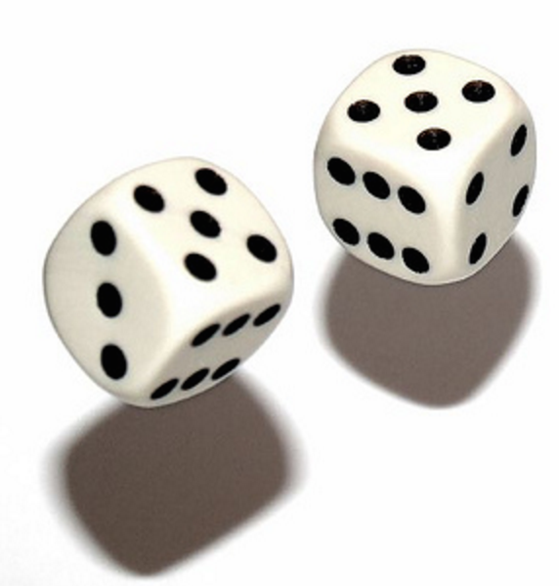
Causality= mechanism
S=0 | 0.5
S=1 | 0.5
 | S=0 | S=1
C=0 | 30/50 | 10/50
C=1 | 20/50 | 40/50
Pr(S)
Pr(C/S)
S
C
Pr(S,C)

Slide 8
Universe 1
S=0 | 0.5
S=1 | 0.5
 | S=0 | S=1
C=0 | 30/50 | 10/50
C=1 | 20/50 | 40/50
Pr(S)
Pr(C/S)
S
C
C=F(S,E)
E ⫫ S
Pr(S,C)

Slide 9
Universe 2
S
C

Slide 10
Universe 2
C=0 | 0.4
C=1 | 0.6
 | C=0 | C=1
S=0 | 30/(100*0.4) = 0.75 | 20/(100*0.6) = 0.33
S=1 | 10/(100*0.4) = 0.25 | 40/(100*0.6) = 0.66
Pr(C)
Pr(S/C)
S
C
S=F(C,E)
E ⫫ C
Pr(S,C)

Slide 11
How to find the causal direction?
Pr(S,C)
Pr(S)
Pr(C/S)
S
C
C=F(S,E)
E ⫫ S

Slide 12
How to find the causal direction?
Pr(S,C)
Pr(S)
Pr(C/S)
Pr(C)
Pr(S/C)
S
C
S
C
C=F(S,E)
E ⫫ S
S=F’(C,E’)
E’ ⫫ S

Slide 13

How to find the causal direction?
It is impossible to find the true causal direction from observational data for two random variables.
(Unless we make more assumptions)
You need interventions, i.e. messing with the mechanism.
For more than two r.v.s there is a rich theory and some directions can be learned without interventions. (Spirtes et al.)
Pr(S,C)
Pr(S)
Pr(C/S)
Pr(C)
Pr(S/C)
S
C
S
C
C=F(S,E)
E ⫫ S
S=F’(C,E’)
E’ ⫫ S

Slide 14
Overview
Discovering causal directions
Part 1: Interventions and how to design them
Chordal graphs and combinatorics
Part 2: A new model: entropic causality
A theorem of identifiability
A practical algorithm for Shannon entropy causal inference
Good empirical performance on standard benchmark
Many open problems

Slide 15
Intervention: force people to smoke
S=0 | 0.5
S=1 | 0.5
 | S=0 | S=1
C=0 | 30/50 | 10/50
C=1 | 20/50 | 40/50
Pr(S)
Pr(C/S)
Flip coin and force each person to smoke or not, with prob ½.
In Universe1 (i.e. Under S→C) ,
new joint pdf stays same as before intervention.
S
C

Slide 16
Intervention: force people to smoke
C=0 | 0.4
C=1 | 0.6
 | C=0 | C=1
S=0 | 30/(100*0.4) = 0.75 | 20/(100*0.6) = 0.33
S=1 | 10/(100*0.4) = 0.25 | 40/(100*0.6) = 0.66
Pr(C)
Pr(S/C)
Flip coin and force each person to smoke or not, with prob ½.
In Universe 2 (Under C→S)
S, C will become independent after intervention.
S
C

Slide 17
Intervention: force people to smoke
C=0 | 0.4
C=1 | 0.6
 | C=0 | C=1
S=0 | 30/(100*0.4) = 0.75 | 20/(100*0.6) = 0.33
S=1 | 10/(100*0.4) = 0.25 | 40/(100*0.6) = 0.66
Pr(C)
Pr(S/C)
Flip coin and force each person to smoke or not, with prob ½.
In Universe 2 (Under C→S)
S, C will become independent after intervention.
So check correlation on data after intervention and find true direction!
S
C

Slide 18
More variables
S₄
S₅
S₁
S₃
S₆
S₂
S₇
True Causal DAG

Slide 19
More variables
S₄
S₅
S₁
S₃
S₆
S₂
S₇
From observational
Data we can learn
Conditional independencies.
Obtain Skeleton
(lose directions)
True Causal DAG

Slide 20
More variables
S₄
S₅
S₄
S₅
S₁
S₃
S₆
S₁
S₃
S₆
S₂
S₇
From observational
Data we can learn
Conditional independencies.
Obtain Skeleton
(lose directions)
S₂
S₇
True Causal DAG
Skeleton

Slide 21
PC Algorithm (Spirtes et al. Meek)
There are a few directions we can learn from observational Data
(Immoralities, Meek Rules)
S₄
S₅
S₁
S₃
S₆
Spirtes, Glymour, Scheines 2001, PC Algorithm
C. Meek , 1995.
Andersson, Madigan, Perlman, 1997
S₂
S₇
Skeleton

Slide 22
PC Algorithm (Spirtes et al. Meek)
There are a few directions we can learn from observational Data
(Immoralities, Meek Rules)
S₄
S₅
S₁
S₃
S₆
Spirtes, Glymour, Scheines 2001, PC Algorithm
C. Meek , 1995.
Andersson, Madigan, Perlman, 1997
S₂
S₇
Skeleton

Slide 23
How interventions reveal directions
We choose a subset of the variables S and
Intervene (i.e. force random values )
S₄
S₅
S₁
S₃
S₆
S₂
S₇
Intervened Set S
={S₁,S₂,S₄}

Slide 24
How interventions reveal directions
We choose a subset of the variables S and
Intervene (i.e. force random values )
Directions of edges from S to S^{c} are revealed to me.
S₄
S₅
S₁
S₃
S₆
S₂
S₇
Intervened Set S
={S₁,S₂,S₄}

Slide 25
How interventions reveal directions
We choose a subset of the variables S and
Intervene (i.e. force random values )
Directions of edges from S to S^{c} are revealed to me.
Re-apply PC Algorithm+Meek rules to learn a few more edges possibly
S₄
S₅
S₁
S₃
S₆
S₂
S₇
Intervened Set S
={S₁,S₂,S₄}

Slide 26
Learning Causal DAGs
Given a skeleton graph, how many interventions are needed to learn all directions ?
A-priori fixed set of interventions (non-Adaptive)
S₄
S₅
S₁
S₃
S₆
S₂
S₇
Skeleton

Slide 27
Learning Causal DAGs
Given a skeleton graph, how many interventions are needed to learn all directions ?
A-priori fixed set of interventions (non-Adaptive)
Adaptive
Randomized Adaptive
S₄
S₅
S₁
S₃
S₆
S₂
S₇
Skeleton

Slide 28
Learning Causal DAGs
Given a skeleton graph, how many interventions are needed to learn all directions ?
A-priori fixed set of interventions (non-Adaptive)
Theorem (Hauser & Buhlmann 2014):
Log(χ) interventions suffice
(χ= chromatic number of skeleton)
S₄
S₅
S₁
S₃
S₆
S₂
S₇
Skeleton

Slide 29
Learning Causal DAGs
Thm: Log(χ) interventions suffice
Proof:
1.Color the vertices. (legal coloring)
S₄
S₅
S₁
S₃
S₆
S₂
S₇
Skeleton

Slide 30
Learning Causal DAGs
Thm: Log(χ) interventions suffice
Proof:
1.Color the vertices.
2. Form table with binary representations of colors
Red: 0 0
Green: 0 1
Blue: 1 0
S₄
S₅
S₁
S₃
S₆
S₁ | 0 | 0
S₂ | 0 | 1
S₃ | 1 | 0
S₄ | 0 | 1
S₅ | 1 | 0
S₆ | 0 | 1
S₇ | 1 | 0
S₂
S₇
Skeleton

Slide 31
Learning Causal DAGs
Thm: Log(χ) interventions suffice
Proof:
1.Color the vertices.
2. Form table with binary representations of colors
Red: 0 0
Green: 0 1
Blue: 1 0
3. Each intervention
is indexed by a column
of this table.
S₄
S₅
S₁
S₃
S₆
S₁ | 0 | 0
S₂ | 0 | 1
S₃ | 1 | 0
S₄ | 0 | 1
S₅ | 1 | 0
S₆ | 0 | 1
S₇ | 1 | 0
S₂
S₇
Skeleton
Intervention 1

Slide 32
Learning Causal DAGs
Thm: Log(χ) interventions suffice
Proof:
1.Color the vertices.
2. Form table with binary representations of colors
Red: 0 0
Green: 0 1
Blue: 1 0
3. Each intervention
is indexed by a column
of this table.
S₄
S₅
S₁
S₃
S₆
S₁ | 0 | 0
S₂ | 0 | 1
S₃ | 1 | 0
S₄ | 0 | 1
S₅ | 1 | 0
S₆ | 0 | 1
S₇ | 1 | 0
S₂
S₇
For any edge, its two vertices have different colors. Their binary reps are different in 1 bit.
So for some intervention, one is in set and other is not. So I will learn its direction. ΟΕΔ.
Intervention 1

Slide 33
Learning Causal DAGs
Given a skeleton graph, how many interventions are needed to learn all directions ?
A-priori fixed set of interventions (non-Adaptive)
Log(χ)
Adaptive
(NIPS15): Adaptive cannot improve for all graphs.
Randomized Adaptive
(Li,Vetta, NIPS14): loglog(n) interventions with high probability suffice for complete skeleton.
S₄
S₅
S₁
S₃
S₆
S₂
S₇
Skeleton

Slide 34
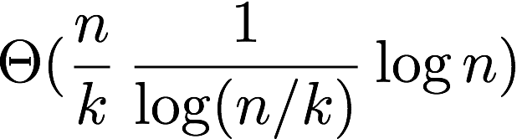
Major problem: Size of interventions
We choose a subset of the variables S and
Intervene (i.e. force random values )
We need exponentially many samples in the size of the intervention set S.
Question: If each intervention has size up to k, how many interventions do we need ?
Eberhardt: A separating system on χ elements with weight k is sufficient to produce a non-adaptive causal inference algorithm
A separating system on n elements with weight k is a {0,1} matrix with n distinct columns and each row having weight at most k.
Reyni, Kantona, Wegener: (n,k) separating systems have size
S₄
S₅
S₁
S₃
S₆
S₂
S₇
Intervened Set S
={S₁,S₂,S₄}

Slide 35
Major problem: Size of interventions
Open problem: Is a separating system necessary or can adaptive algorithms do better ?
(NIPS15): For complete graph skeletons, separating systems are necessary.
Even for adaptive algorithms.
We can use lower bounds on size of separating systems to get lower bounds on the number of interventions.
Randomized adaptive: loglogn interventions
Our result: n/k loglog k interventions suffice , each of size up to k.
S₄
S₅
S₁
S₃
S₆
S₂
S₇
Intervened Set S
={S₁,S₂,S₄}

Slide 36
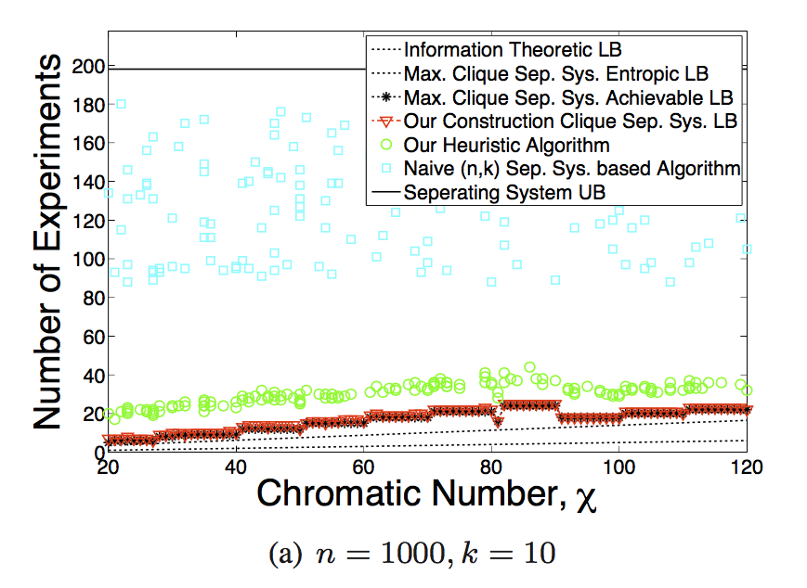
A good algorithm for general graphs

Slide 37
Overview
Discovering causal directions
Part 1: Interventions and how to design them
Chordal graphs and combinatorics
Part 2: A new model: entropic causality
A theorem of identifiability
A practical algorithm for Shannon entropy causal inference
Good empirical performance on standard benchmark
Many open problems

Slide 38
Data-driven causality
How to find causal direction without interventions
Impossible for two variables. Possible under assumptions.
Popular assumption Y= F(X) + E, (E ⫫ X) (Additive models)(Shimizu et al., Hoyer et al., Peters et al. Chen et al., Mooij et al.)
This work: Use information theory for general data-driven causality. Y= F(X,E), (E ⫫ X)
(related work: Janzing, Mooij, Zhang, Lemeire: not additive assumption but no noise. Y=F(X) )

Slide 39
Entropic Causality
Given data Xi,Yi.
Search over explanations assuming X→Y
Y= F(X,E) , (E ⫫ X)
Simplest explanation: One that minimizes H(E).
Search in the other direction, assuming Y→X
X= F’(Y,E’) , (E’ ⫫ Y)
If H(E’) << H(E) decide Y→X
If H(E) <<H(E’) decide X→Y
If H(E), H(E’) close, say ‘don’t know’

Slide 40
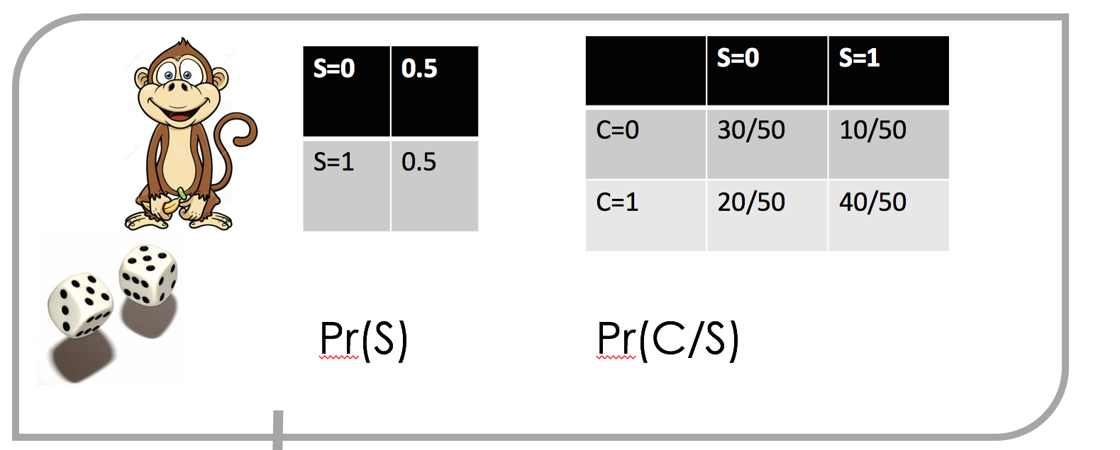
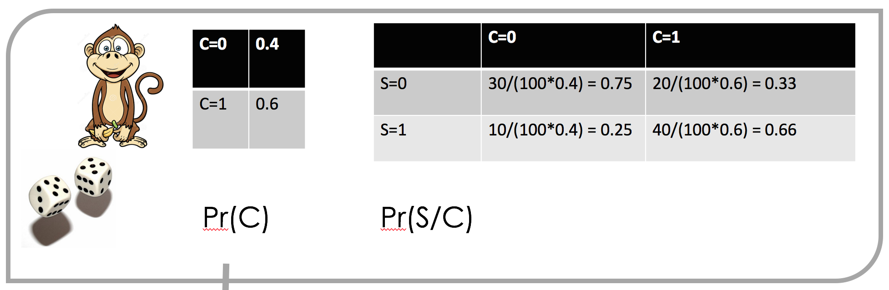
Entropic Causality in pictures
S
C
S
C
C= F(S,E) , (E ⫫ S)
H(E) small
S= F’(C,E’) , (E’ ⫫ C)
H(E’) big

Slide 41
Entropic Causality in pictures
You may be thinking that min H(E) is like minimizing H(C/S).
But it is fundamentally different
(we’ll prove its NP-hard to compute)
S
C
S
C
C= F(S,E) , (E ⫫ S)
H(E) small
S= F’(C,E’) , (E’ ⫫ C)
H(E’) big

Slide 42
Question 1: Identifiability?
If data is generated from X→Y , i.e. Y= f(X,E), (E ⫫ X) and H(E) is small.
Is it true that all possible reverse explanations
X= f’(Y,E’) , (E’ ⫫ Y) must have H(E’) big, for all f’,E’ ?
Theorem 1: If X,E,f are generic, then identifiability holds for H₀ (support of distribution of E’ must be large).
Conjecture 1: Same result holds for H₁ (Shannon entropy).

Slide 43
Question 2: How to find simplest explanation?
Minimum entropy coupling problem: Given some marginal distributions U₁,U₂, .. U_{n} , find the joint distribution that has these as marginals and has minimal entropy.
(NP-Hard, Kovacevic et al. 2012).
Theorem 2: Finding the simplest data explanation f,E, is equivalent to solving the minimum entropy coupling problem.
How to use: We propose a greedy algorithm that empirically performs reasonably well

Slide 44
Proof idea
Consider Y = f(X, E). (X,Y over n sized alphabet.)
p_{i,j} =P(Y = i|X=j) = P(f(X,E) = i | X = j) = P( f_{j}(E) = i ) since E ⫫ X
e₁
e₂
e₃
e₄
e₅
e₆
.
.
.
e_{m}
f₁
Each conditional probability is a subset sum of distribution of E
S_{i,j}: index set for p_{i,j}
p_{1,1}
p_{2,1}
p_{3,1}
.
.
.
p_{n,1}
Distribution of Y conditioned on X = 1
Distribution of E

Slide 45
Performance on Tubingen dataset
Decision rate:
Fraction of pairs that algorithm makes a decision.
Decision made when
|H(X,E)-H(Y,E’)|> t
(t determines the decision rate)
Confidence intervals based
on number of datapoints
Slightly better than ANMs

Slide 46
Conclusions 1
Learning causal graphs with interventions is a fun graph theory problem
The landscape when the sizes of interventions is bounded is quite open, especially for general graphs.
Good combinatorial algorithms with provable guarantees?

Slide 47
Conclusions 2
Introduced a new framework for data-driven causality for two variables
Established Identifiability for generic distributions for H₀ entropy. Conjectured it holds for Shannon entropy.
Inspired by Occam’s razor. Natural and different from prior works.
Natural for categorical variables (Additive models do not work there)
Proposed practical greedy algorithm using Shannon entropy.
Empirically performs very well for artificial and real causal datasets.

Slide 48
fin

Slide 49
Existing Theory: Additive Noise Models
Assume Y = f(X)+E, X⫫E
Identifiability 1:
If f nonlinear, then ∄ g, N ⫫Y such that X = g(Y)+N (almost surely)
If E non-Gaussian, ∄ g, N ⫫Y such that X = g(Y)+N
Performs 63% on real data*
Drawback: Additivity is a restrictive functional assumption
* Cause Effect Pairs Dataset: https://webdav.tuebingen.mpg.de/cause-effect/

Slide 50
Existing Theory: Independence of Cause and Mechanism
Function f chosen “independently” from distribution of X by nature
Notion of independence: Assign a variable to f, check log-slope integral
Boils down to: X causes Y if h(Y) < h(X) [h: differential entropy]
Drawback:
No exogenous variable assumption (deterministic X-Y relation)
Continuous variables only

Slide 51
Open Problem
Work in most general functional form Y = f(X,E)
Handle ordinal as well as categorical data

Slide 52
Our Approach
Consider discrete variables X, Y, E.
Use total input (Renyi) entropy as a measure of complexity
Choose the simpler model
Assumption: (Renyi) entropy of exogenous variable E is small
Theoretical guarantees for H₀ Renyi entropy (cardinality)
Causal direction (almost surely) identifiable if E has small cardinality

Slide 53
Performance of Greedy Joint Entropy Minimization
n marginal distributions each with n states are randomly generated for each n
The minimum joint entropy obtained by the greedy algorithm is at most 1 bit away from the largest marginal max_{i}H(X_{i})

Slide 54
Results Shannon Entropy-based Identifiability
Generate distributions of X,Y by randomly selecting f, X, E.
Probability of success is the fraction of points where H(X,E) < H(Y,N).
Larger n drives probability of success to 1 when $H(E) < log(n), supporting the conjecture.

Slide 55
Characterization of Conditionals
Define conditional distribution
Let p = [p₁^{T}, p₂^{T}, …, p_{n}^{T}]^{T}. Then
Ex.:
where M is a block partition matrix:
Each block of length n is a partitioning of columns

Slide 56
General Position Argument
Suppose Y|X = j are uniform over simplex (not realistic, toy example)
Note: Let x_{i} ∼ exp(1). Then following is a uniform random vector over the simplex:
Drop n rows of p to make it (almost) i.i.d.
Claim: There does not exist an e with H0 < n(n-1)
Proof: Assume otherwise.
Rows of M are linearly dependent.
∃ a such that a^{T} M = 0
Then a^{T}p = 0
Implies a random hyperplane being orthogonal to a vector, has probability 0.

Slide 57
Our contribution
Nature chooses X, E, f. Joint distribution over X, Y implied
Choose X, E randomly over simplex.
Derive X|Y from induced joint
Any ⫫ Y for which X = g(Y, ) implies
Corresponds to a non-zero polynomial being zero, has probability 0.

Slide 58
Formal Result
X, Y discrete r.v.’s with cardinality n
Y = f(X,E) where E ⫫ X is also discrete
f is generic (technical condition to avoid edge cases, true in real data)
Distribution vectors of X, E uniformly randomly sampled from simplex
Then with probability 1, there does not exist N ⫫ Y such that there exist g that satisfies X = g(Y, N)

Slide 59
Working with Shannon Entropy
Given Y|X, finding E with minimum Shannon entropy such that there is f that satisfies Y = f(X,E) is equivalent to
Given marginal distributions of n variables X_{i}, find the joint distribution with minimum entropy
NP hard problem.
We propose a greedy algorithm (that produces a local optimum)

